Slide 1
CS3343 Project Report
Prepared by Team HW
Siyan Yuan, Jenny Wang, Gavin Duan, Benson Zhang, KK & Bill

Slide 2
Overview
Project aim:
A software to calculate the similarity of two pieces of source codes in C
Team organization:
PM: Coffee Yuan
CM: Jenny Wang
Development & Test led: Huayi Duan
Pair Programmers:
Gavin Duan & Jenny Wang
Coffee Yuan & Benson Zhang
KK & Bill

Slide 3
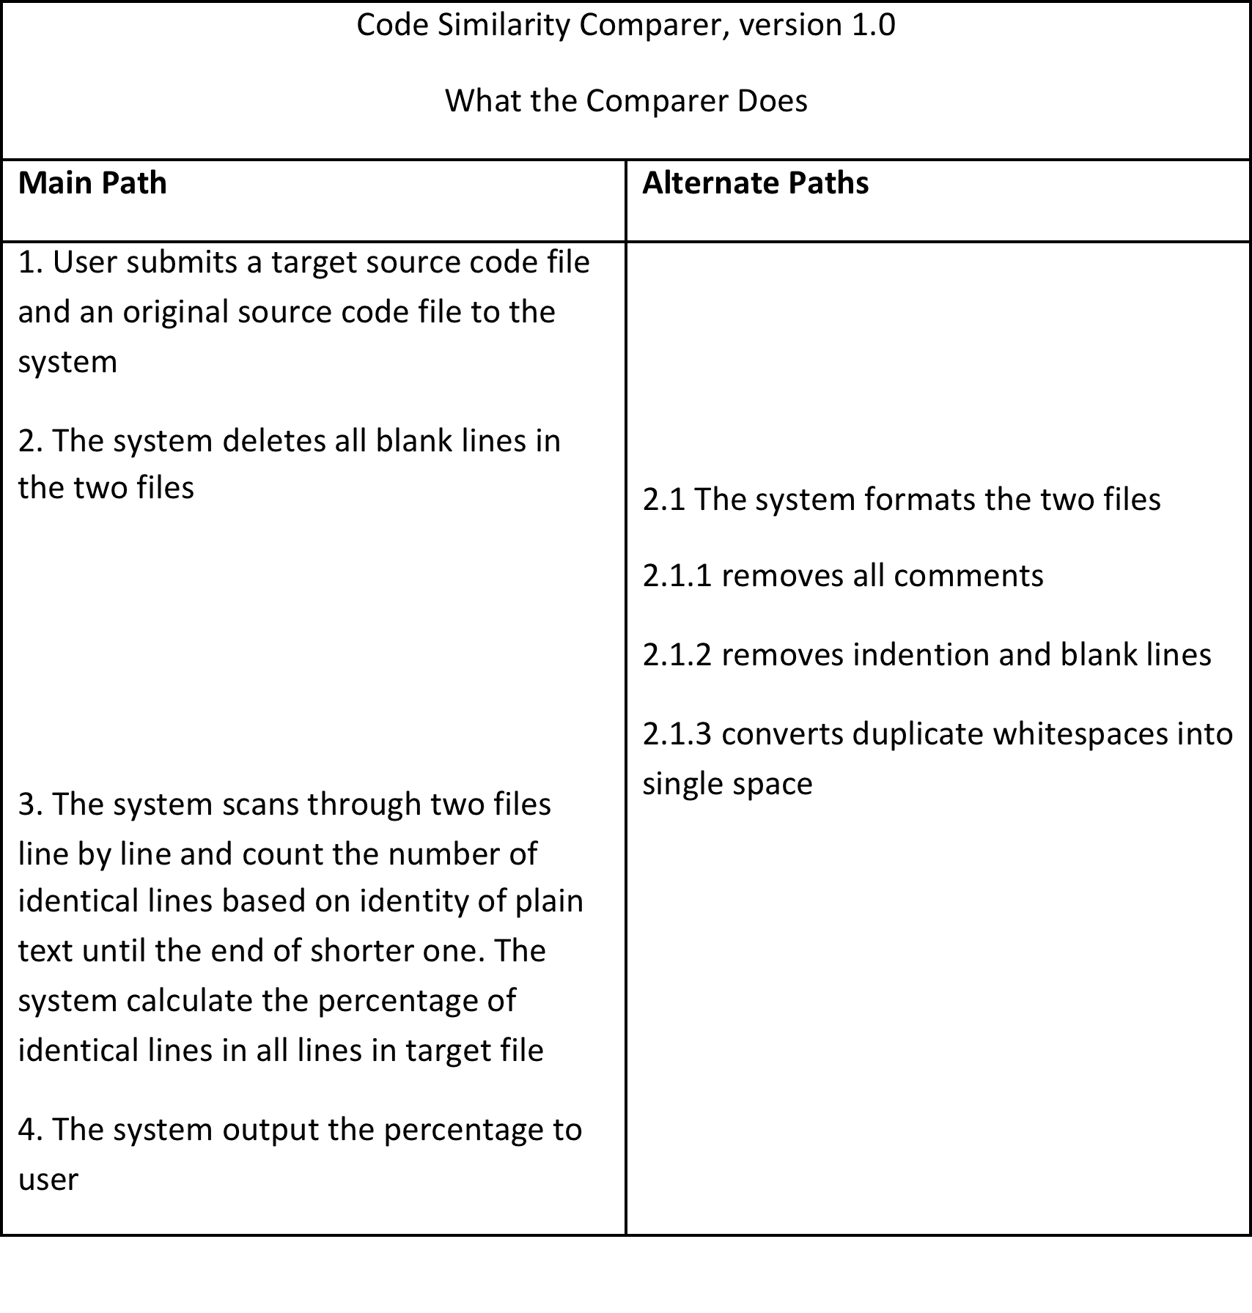
User Story

Slide 4
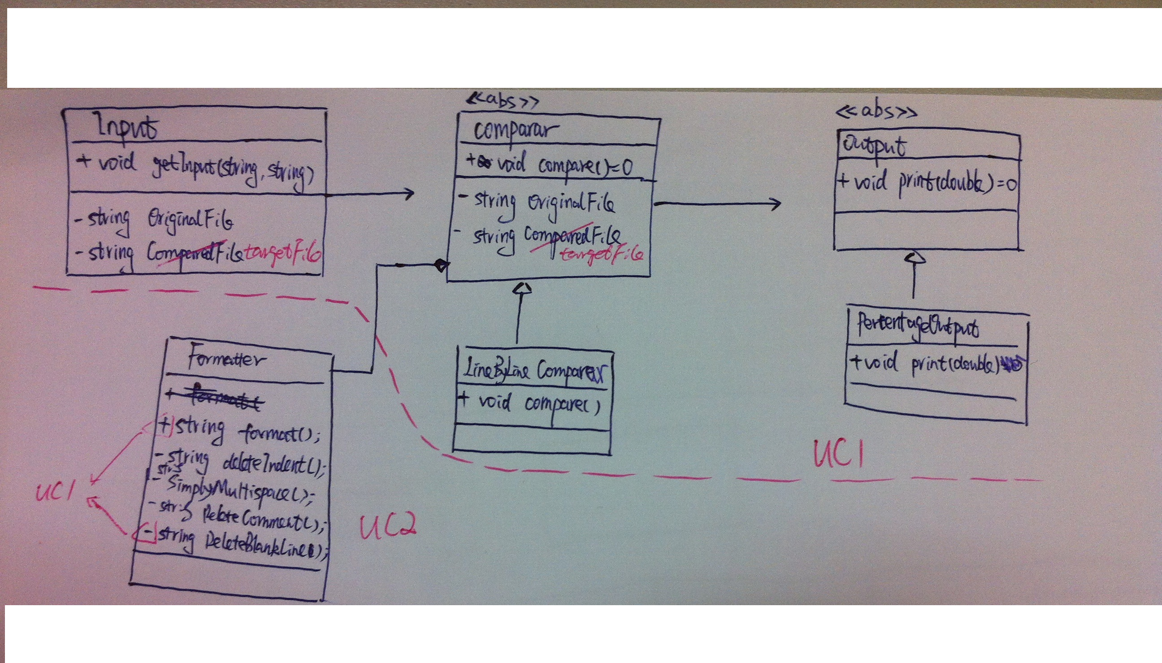
Class Diagram

Slide 5
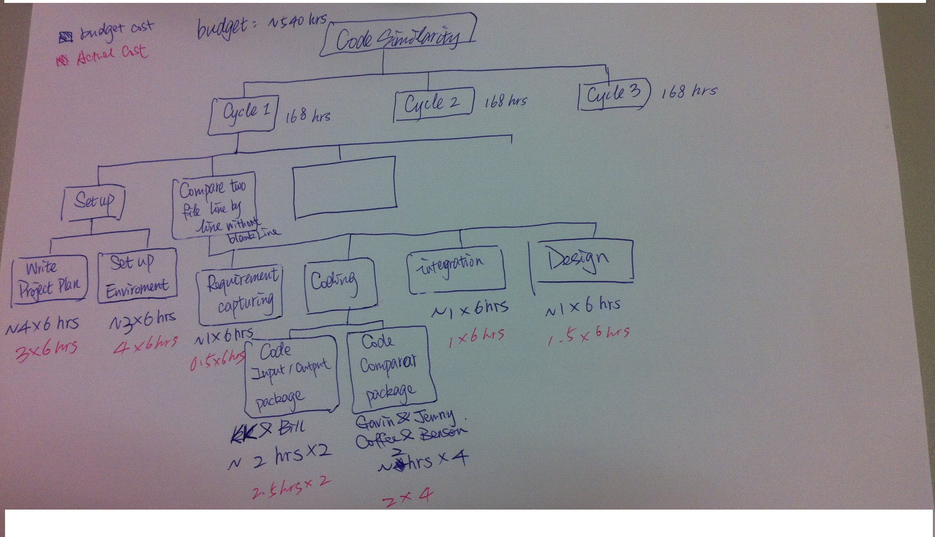
WBS

Slide 6
Progress report
User stories produced:
User Story I & II
User stories completed:
User Story I
User stories to be accomplished by Week 5:
User Story II
To be handed in Cycle 1:
User stories I & II

Slide 7
Q & A
Thanks for your time.

